Slide 1

UN FRAMEWORK PER IL NATURAL LANGUAGE PROCESSING:
ANALISI PRESTAZIONALE PER LA RISOLUZIONE DI TASK DI TEXT CLASSIFICATION E NAMED ENTITY RECOGNITION IN AMBIENTE DISTRIBUITO
Bachelor’s Degree
Advisor:
Prof. Roberto Basili
Co-rapporteur:
Prof. Danilo Croce
Candidate:
Manuel Di Lullo
Macroarea di Scienze Matematiche, Fisiche e Naturali - Corso di Laurea in Informatica a.a. 2020/2021

Slide 2
Outline
Unstructured information processing in the era of big data
Aim of the thesis: study and implementation of a distributed computing approach
Solution proposed and implemented
HDFS, MapReduce, YARN, Spark, Spark NLP
Experimental evaluation
Text Classification e Named Entity Recognition
Conclusions

Slide 3
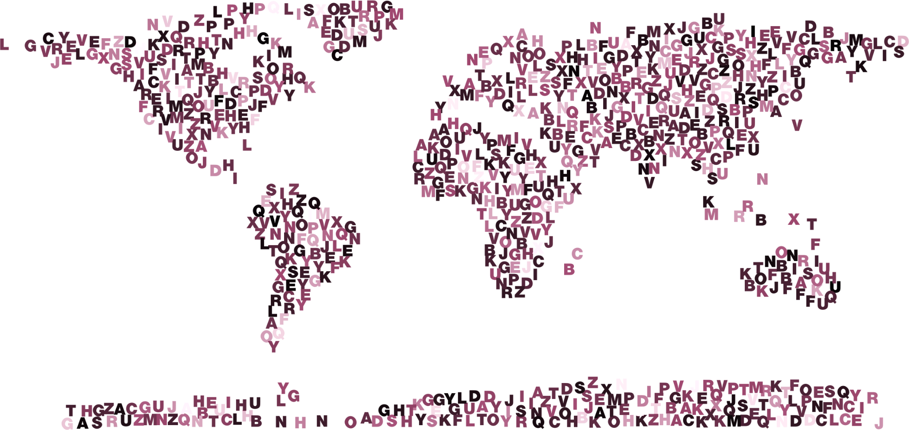
A world made of data
319.6 bilions
Of mail sent in 2021
100 bilions
Of WhatsApp messages in 2021
1.8 bilions
Of active Facebook users in 2021
463 Exabyte
data generated daily in 2025
Source: statista.com

Slide 4




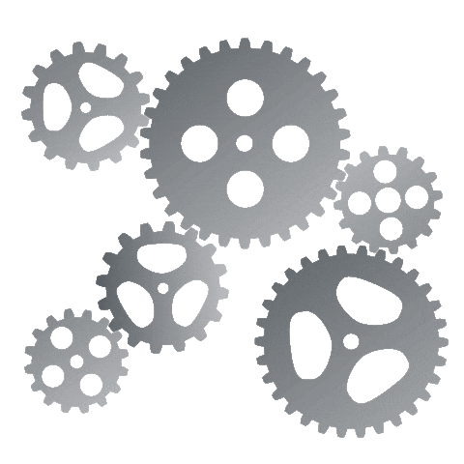
An example of distributed computing
Field of computer science that studies distributed systems, that are systems that consist of numerous computers that interact with each other through a network in order to achieve a common goal.
Model example: master/slave architecture
Worker 1
Worker 2
Master
Worker n

Slide 5

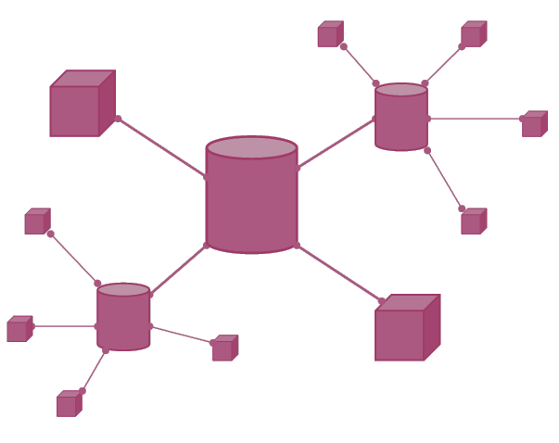

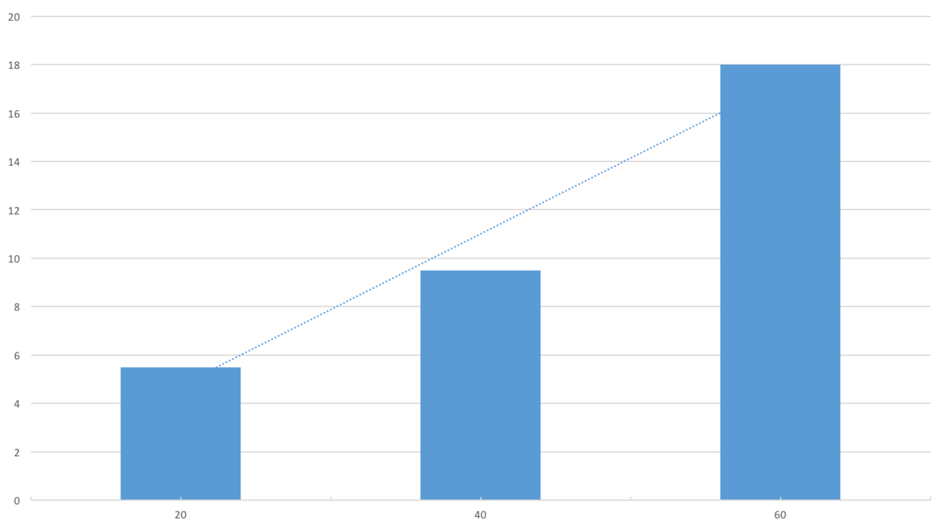
Aim of the thesis
Study and definition of the Hadoop ecosystem for distributed calculation of unstructured data
Implementation of a distributed environment with the help of Hadoop and Apache Spark
1
2
Study of models for the resolution of linguistic tasks and the Spark NLP framework
Experimental model evaluation. Measurement of the accuracy and scalability of the solution.
3
4

Slide 6
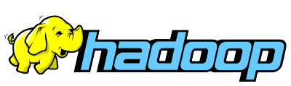
Framework for distributed computing
Hadoop is a framework that allows distributed processing of large data sets in a distributed environment
In this thesis the following modules were treated::
Hadoop Distributed File System (HDFS): for file management in a distributed environment
Hadoop MapReduce: for the distributed processing of data
Hadoop Yet Another Resource Negotiator (YARN): for the resource management
Documentazione Hadoop qui

Slide 7
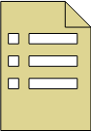
Hadoop Distributed File System
DataNode 1
File management in distributed environment
NameNode
b1
b3
…
Hierarchical and distributed file system
NameNode
DataNode 2
Used to ensure that all cluster nodes have a shared view of data and models
b1
b2
…
b1
b2
b3
…
Highly fault tolerant
Files divided into blocks and distributed between nodes
Blocks replication
DataNode n
b2
b3
…
Documentazione HDFS qui

Slide 8
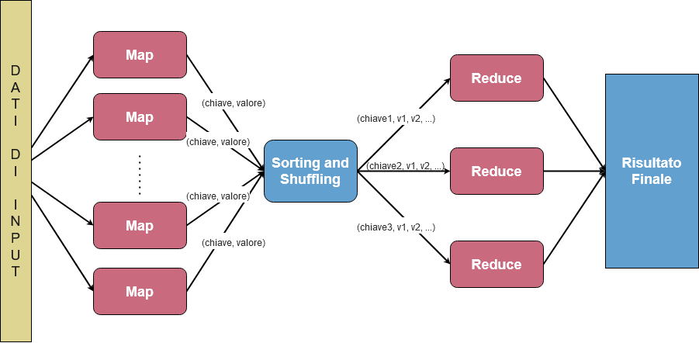
Hadoop MapReduce
Paralled data processing
Mapreduce takes care of the distributed processing of files stored on HDFS.
Composed mainly of two functions: Map and Reduce
Divide et impera:
The master node divides the calculation operation into jobs and assigns them to the various nodes of the system
Jobs are processed autonomously on worker nodes
The master reduces the individual results obtained by the worker nodes to a single final result
Documentazione MapReduce qui

Slide 9

Apache Spark
Open source distributed computing engine
Used as an alternative to MapReduce
Inherits MapReduce’s Master-Slave architecture and solves problems in the latter
Spark SQL
Spark Streaming
Spark ML
Spark GraphX
Spark NLP
Compatible with YARN e HDFS
YARN allocates and monitors the resources needed for the application
Spark uses models and files stored on HDFS
Spark Core
Spark Core APIs and libraries for data analysis
Documentazione Spark qui

Slide 10
Spark NLP
Spark NLP is an open source natural language processing library.
It is built on Apache Spark and Spark ML and is compatible with distributed processing frameworks such as Hadoop.
Implements Machine Learning pipelines that represent the steps that a model must take
It has dozens of annotators, many of which use neural networks to classify texts.
Tokenization
[‘Putin’, ‘recognizes’, ‘indipendence’, ‘of’, ‘Donbass’]
Stemming
['putin', 'recogn', 'independ', 'of', 'donbass']
Putin recognizes independence of Donbass
Named Entity Recognition
[‘Putin’:'B-PER', ‘Donbass’:'B-ORG']
Text Classification
Politics

Slide 11
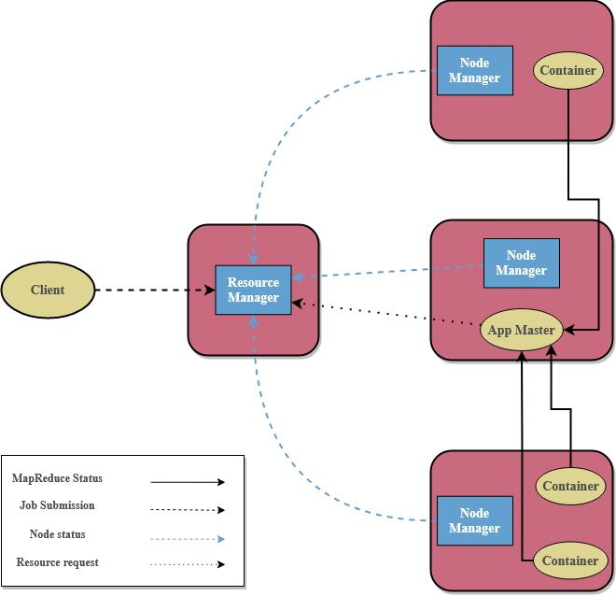
Hadoop YARN
Resource management and jobs scheduling
Scheduling of jobs and management of cluster resources.
Register applications and adds them to the job queue to run
Allocate resources for each application
Monitor the status of resources on each node
Divided into three components:
ResourceManager: master process of YARN
NodeManager: responsible for monitoring the resources for each machine.
ApplicationMaster: negotiate resources from ResourceManager and work with NodeManagers to run and monitor jobs.
Documentazione YARN qui

Slide 12





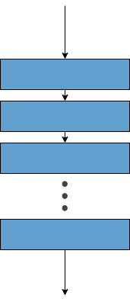

Distributed computing with Spark e Hadoop
Master node
Worker 1
Client
Worker n

Slide 13
Experimetal evaluation
Aim of experimental phase:
Measure accuracy using state-of-the-art models
Measure the scalability offered by Spark NLP running on a distributed system.

Slide 14
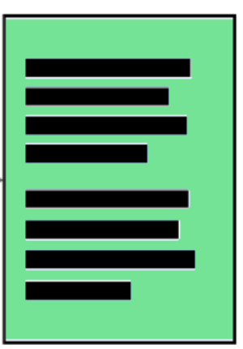
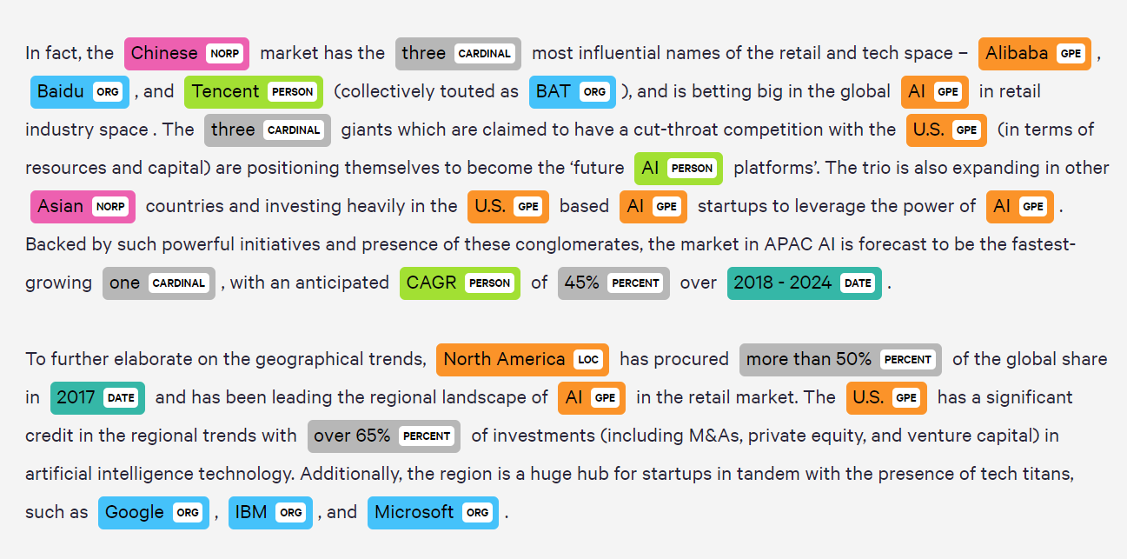
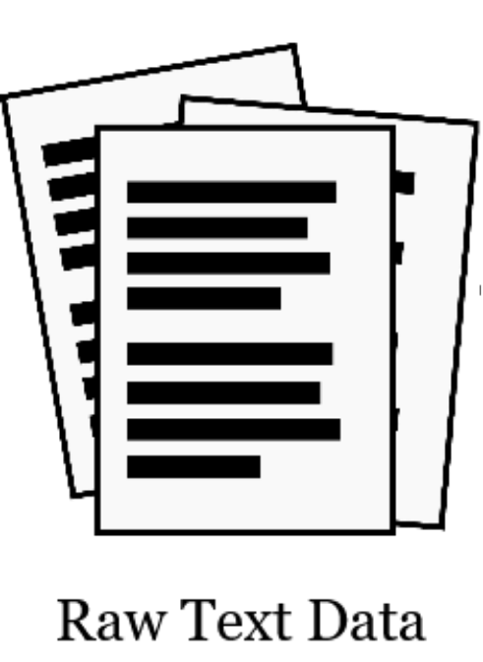
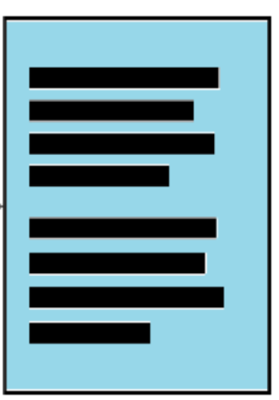

Tasks addressed
Text Classification
(Topic Detection)
Entity Extraction
(Named Entity Recognition)
Sci/Tech
World
Business
Sport

Slide 15
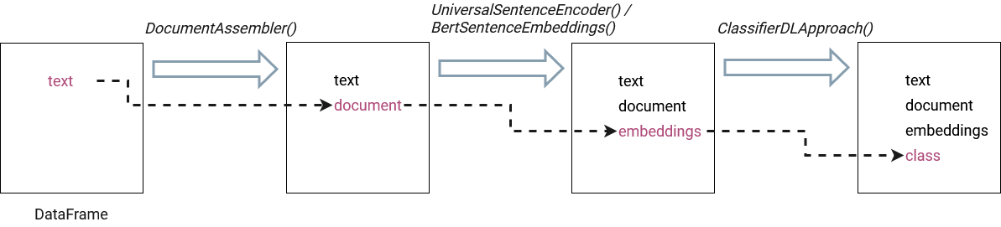
Spark NLP for Text Classification
Dataset reading
Training examples: 120.000 Testing examples: 7.600 Labels: Business Sci/Tech World Sports
Pipeline
.fit()
PipelineModel
.transform()
DataFrame
Results

Slide 16
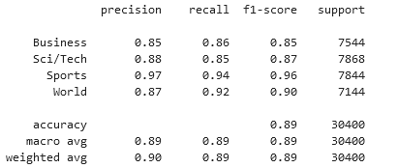
Results
Suppose we have as reference a model that, for every example present in the rating dataset, always returns the same class.
In our dataset the number of examples for each class is the same, therefore, it would get an accuracy of 25%
The model used in this thesis achieves the following results:
Errore example:
“Richard Faulds and Stephen Parry are going for gold for Great Britain on day four in Athens.”
"Supporters and rivals warn of possible fraud; government says Chavez's defeat could produce turmoil in world oil market."
Expected label:
'World'
Expected label:
'World'
Predicted label:
“Sports”
Predicted label:
'Business'

Slide 17

Execution time
# Examples: 750.000 | 1 executor | 2 executors
BERT | 8h 6min 03s
4h 6min 05s
Adding an executor we expect half the time
The expectations have been met!

Slide 18
Conclusions
Scalability
Accuracy
Prospects
Great results:
Execution times decrease linearly with respect to the number of executors
Significant results
State-of-the-art tools and models easily implementable
Learn more about the options provided by the framework
Experimentation on larger clusters
Use of different models
Testing of heterogeneous datasets

Slide 19
Thank you!
Are there any questions?

Slide 20
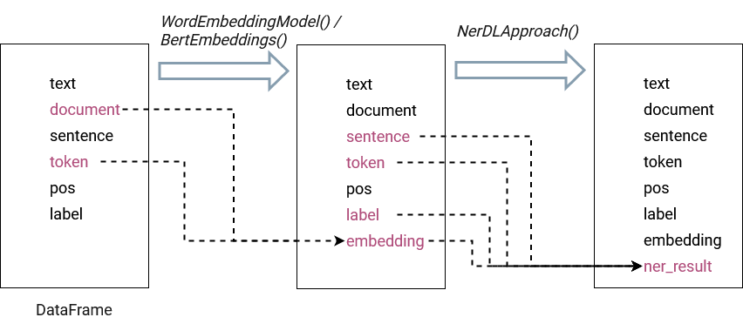
Spark NLP for NER
Dataset reading
Italian | English
Training examples: 11.227 Testing examples: 4.136 Format: CoNLL 2003 Entities: Persone Luoghi Organizzazioni Entità geopolitiche | Training examples: 14,041 Testing examples: 6.603 Format: CoNLL 2003 Entities: Person Location Organization Miscellaneous
Pipeline
.fit()
PipelineModel
.transform()
DataFrame
Results

Slide 21
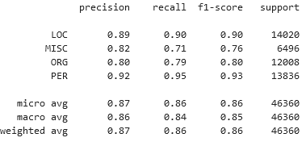
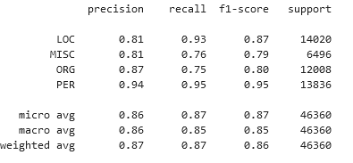
Risultats
GloVe Embeddings
BERT Embeddings
NER in English
Source: https://paperswithcode.com
Notes:
A macro-average will compute the metric independently for each class and then take the average hence treating all classes equally, whereas a micro-average will aggregate the contributions of all classes to compute the average metric. Weighted: average considering the proportion for each label in the dataset

Slide 22
Resources
Template Slidesgo
Icons: Flaticon
Pictures: Freepik, Pixabay
Illustrations: Stories by Freepik

